Slide 1
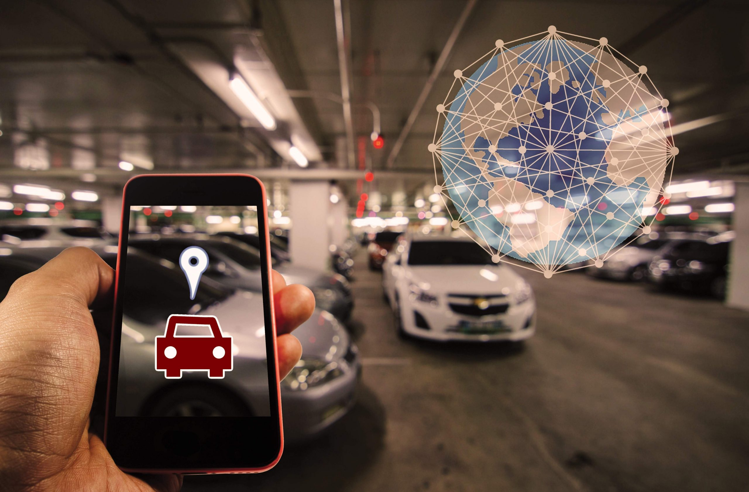
SMART PARKING SYSTEM
Team Members
U.K.S.N.Bandara – 919
M.F.M.Yahya - 1005
B.M.V.N.Sarathkumara – 1008
S.Tharshithan - 1060
T.V.T.I.Vithanage - 1224

Slide 2
Introduction
Now days finding parking in busy areas is very hard and there is no system to get the details of parking availability online.
If you can get the parking slot availability information on your phone and you don’t have roaming around to check the availability.
This problem can be solved by the IoT based smart parking system using the IoT based parking system you can easily access the parking slot availability over the internet.
This system can completely automate the car parking system from your entry to the payment and exit all can be done automatically.

Slide 3

Problem statement
The number of cars is increasing day by day. The main problem is finding a parking space. On average, people spend 20 minutes trying to find a suitable parking space. Most people park their cars in undesignated spaces and park in unreserved spaces. This causes disruption to traffic and sometimes passenger traffic. There are usually reasons for people parking in unreserved parking spaces of cars, and most people park the car for a long time without thinking.

Slide 4
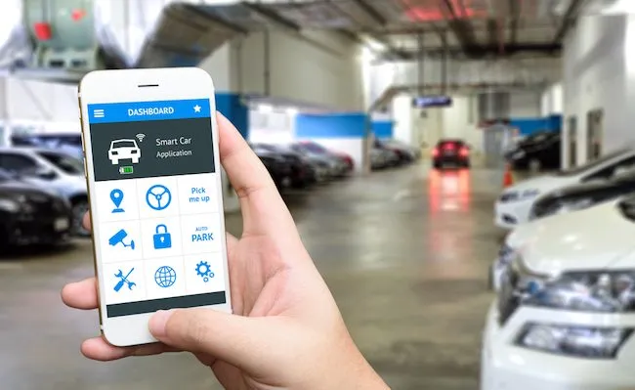
OBJECTIVES
Smart parking system to reduce the time taken and the hassle factor of locating an available parking space.
Accommodating many cars
Car parking is organized and easy.
Access to vacant positions Prevent vehicle theft and vandalism

Slide 5
METHODOLOGY
IR sensors and Servo motors are connected to the NodeMCU Esp8266.
IR sensors are utilized in this project to detect the presence of a vehicle and automatically open and close the gate.
Another three IR sensors are used to detect if the parking slot is available or occupied and send the data to NodeMCU.
NodeMCU controls the entire process of parking system.
It sends the parking availability and parking time information to Adafruit IO platform.
It can be monitored from anywhere in the world.
Adafruit IO dashboard has two buttons to manually operate the entry and exit gate.

Slide 6
WORKING PRINCIPLE
IOT based Car Parking System use NodeMCU, five IR sensors, and two servo motors.
Two IR sensors are used at entry and exit gate to detect the car while three IR sensors are used to detect the parking slot availability.
Servo motors are used to open and close the gates according to the sensor value.
Adafruit IO platform use to show the data on cloud which can be monitored from anywhere in the world.

Slide 7
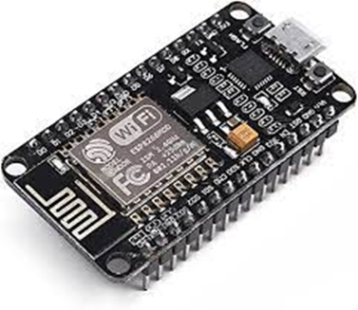
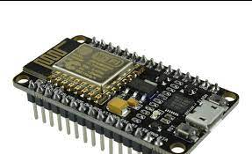
Hardware components
NodeMCU ESP8266
NodeMCU ESP8266 is an open-source based firmware and development board specially targeted for IoT based applications.
hardware which is based on the ESP-12 module, and like this, it can also be programmed using Arduino IDE and can act as both WiFi Hotspot or can connect to one

Slide 8
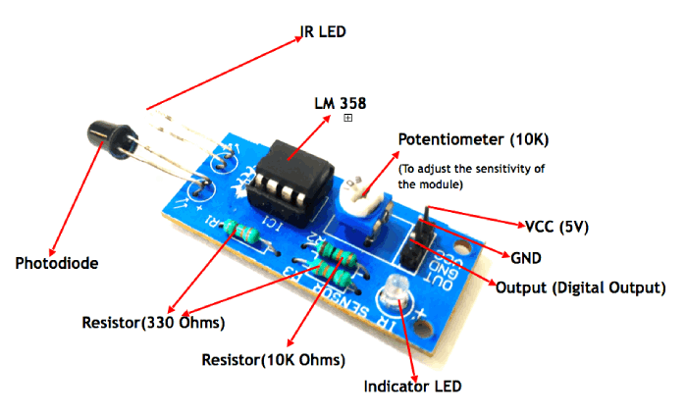
IR Sensors
IR Sensor module consists of an IR transmitter LED which transmits IR light, this light will then be picked up by an IR receiver LED if it gets reflected by any object in front of it.
It is commonly used in Line following robots, proximity sensing, object detection, etc:

Slide 9
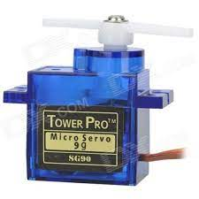
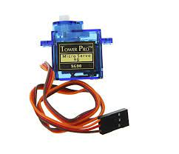
Servo motor
The Tower Pro SG90 9g mini servo motor is the most commonly used servo motor in RC applications.
The servo motors are used for control applications that require precision control like robot arm positioning, and tool position in machining equipment.

Slide 10
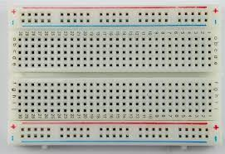
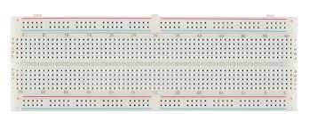
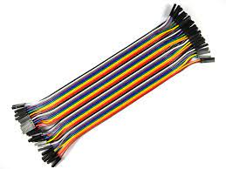
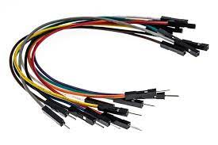
Breadboard
Jumper wires

Slide 11
Software components
Adafruit IO
Arduino ide
zapier

Slide 12
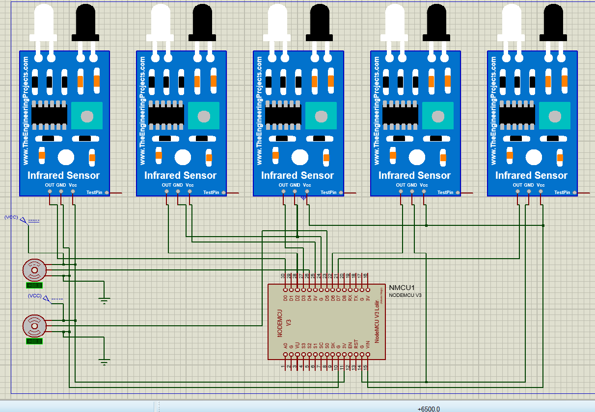
Circuit diagram

Slide 13
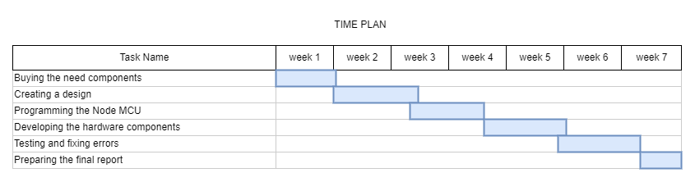
TIME PLAN

Slide 14
BUDGET
Name | Qty. | Price in each item (Rs.) | Price (Rs.)
Nodemcu esp8266 | 1 | 1370 | 1370
Bread board | 1 | 450 | 450
Servo motor | 2 | 650 | 1300
IR sensors | 5 | 140 | 700
Jumper wires(male to male) | 1 | 200 | 200
Jumper wires(male to female) | 1 | 250 | 250
TOTAL |  |  | 4270

Slide 15
FUTURE IMPLEMENTATION
The display will be used to detect the availability of parking lots as well as accept different payment methods.
Linked to smartphones via mobile apps, allowing customers to reserve parking spaces using their phones.
Linked to GPS systems
Track vehicle speed in the vehicle park.

Slide 16
CONCLUSION
Our project proposes an IoT-based Smart parking system to avoid traffic congestion, random parking, and traffic obstruction in the parking area, as well as searching for and waiting for a parking space. It is clear that the demand for smart car parking systems will increase in the coming years. Despite the fact that a smart parking system already exists. Our project aims to make the system more cost-effective and user-friendly, thereby increasing market adoption. The project was both successful and cost-effective, as well as user-friendly.

Slide 17
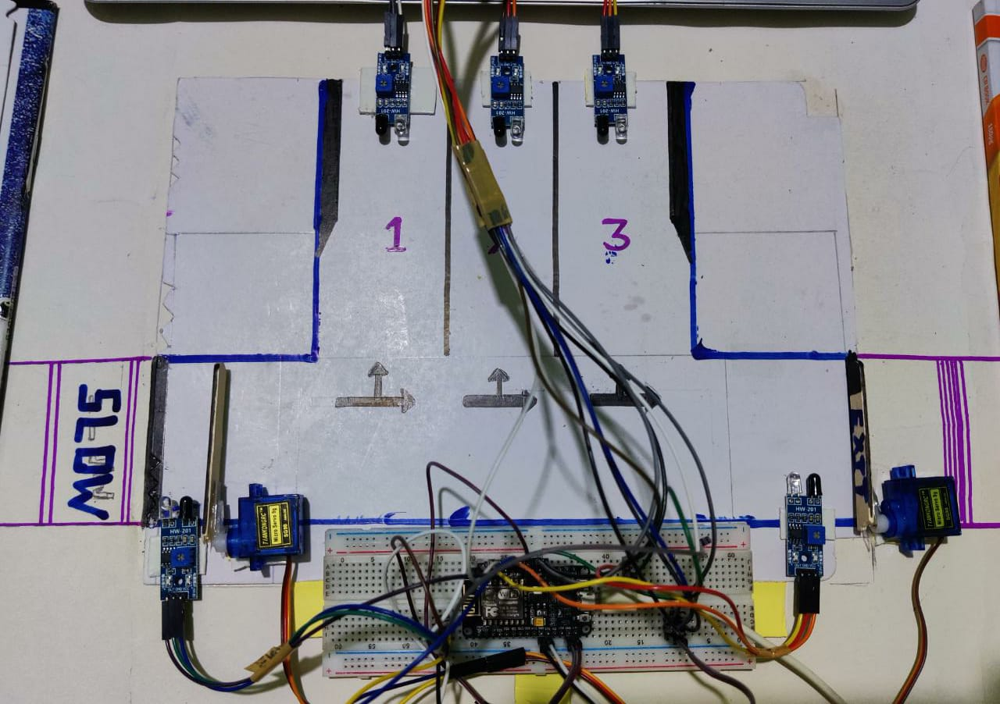
Demonstration

Slide 18
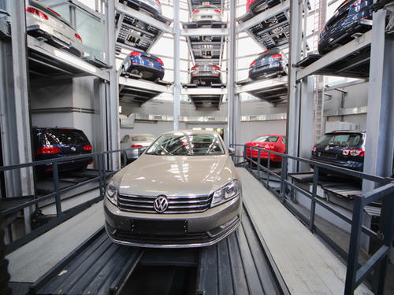
THANK YOU

